Slide 1
Installations July 2018
Mikael Jakobsson
ESS Installation Manager
www.europeanspallationsource.se

Slide 2
Agenda
Installations are ongoing
How we do installations
Installation Process
Installation Organization
Installation Web
Partners and Installations
Installation support & services

Slide 3
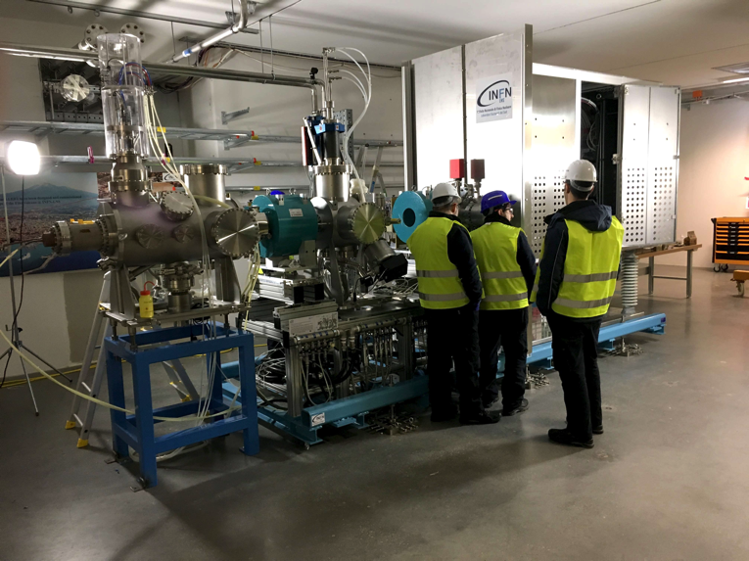
Installations are ongoing Ion Source & LEBT

Slide 4
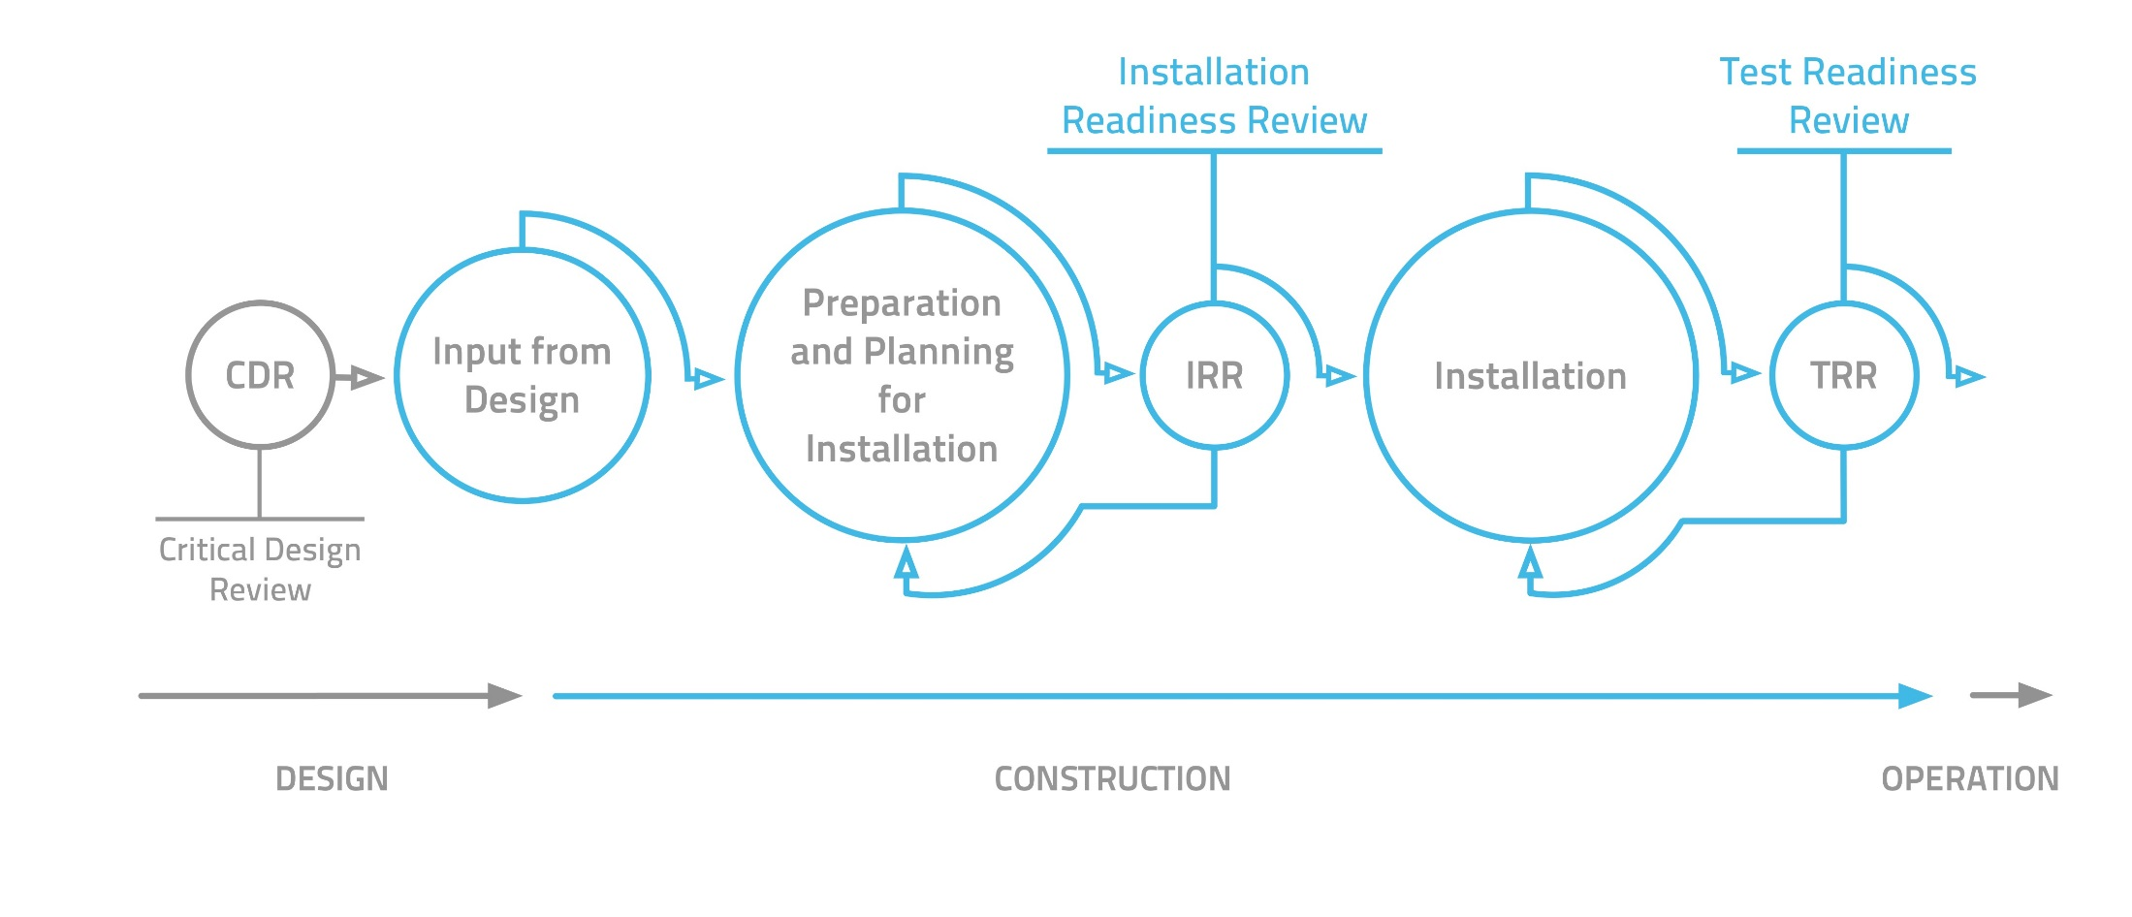
ESS Installation Process
Notes:
The process is the workflow that guides the installation community from the last part of Design to the part preceding operation.
As highlighted in ESS Engineering Handbook, we have five key steps, as shown in the image.
Key message: during the workshop you will see different parts of the SAME process. There is only one process, which is the way ESS works.

Slide 5
ESS Installation Process and related documentation
- Drawings
- Installation & Test Docs
- List of Components & Material
- Reference Documents
- P&ID
- Commissioning Plans
- Description of Work
- Responsibility Matrix Organisation
- Installation Time Schedule
- Temporary Service
- Installation Procedures
- Certificates and Permits
- Work Instructions and Work Risk Assessment
- Work Order
- Installation Binders
- Signed Readyness Review
- Check List/Report
- Approved Installation Plan
- Check List/Protocol Form
- PJB Meeting
- Daily Notes
- Progress Reports
- BIA
- List of NCRs
- Status Follow-Up
- Inspection Plans
Protocols
- Signed Test Readiness Review
- List of Outstanding
- Activities and NCRs
- Red Lines Drawings and other Documents
- Installation Binders
- Certificate of Compliance
- Preliminary As-Built Documents
Notes:
For each step of the process, there is a set of things to do. These actions result in the creation of documents that you keep in your installation binder.

Slide 6
ESS Installation ESS Project and Installation Organisations
Installation Manager ESS
Installation Coordinator
NSS
Installation Coordinator
Accelerator
Installation Coordinator
Target
Installation Coordinator ICS
Target Project
Remote Handling Systems
Monolith Systems
Fluid Systems
Installation Package
Installation Package
Installation Package
Installation Package
Support/coordinate/
prioritize/compliance
Responsibility/accountability and budget
Notes:
How the installation organization relates to the existing project organization.
If we take the example of Target, one of the six projects of the ESS overall project:
Projects are responsible for installation! (and have the budget)
The Installation organization is responsible for the coordination of installation works.

Slide 7
ESS Installation Organisation
ESS Installation Manager
Mikael Jakobsson
NSS Installation Coordinator
Antonio Bianchi
Accelerator Installation Coordinator
Peo Gustavsson
Target Installation Coordinator
Tobias Lexholm
ICS Installation Coordinator
Nour Akel
Area Coordinator
E01-E05 Experimental Halls
Area Coordinator
D01, D03 Experimental Halls
Area Coordinator
D02 - Target Building
Area Coordinator
G01 - Acc Tunnel
Area Coordinator
G02 - Klystron Gallery
Area Coordinator G04 - Cryo-Compressor Building
Notes:
This is how the new organization looks like.
About the Installation Coordinators:…
About the Installation Manager:…
About the Area Coordinators:…

Slide 8
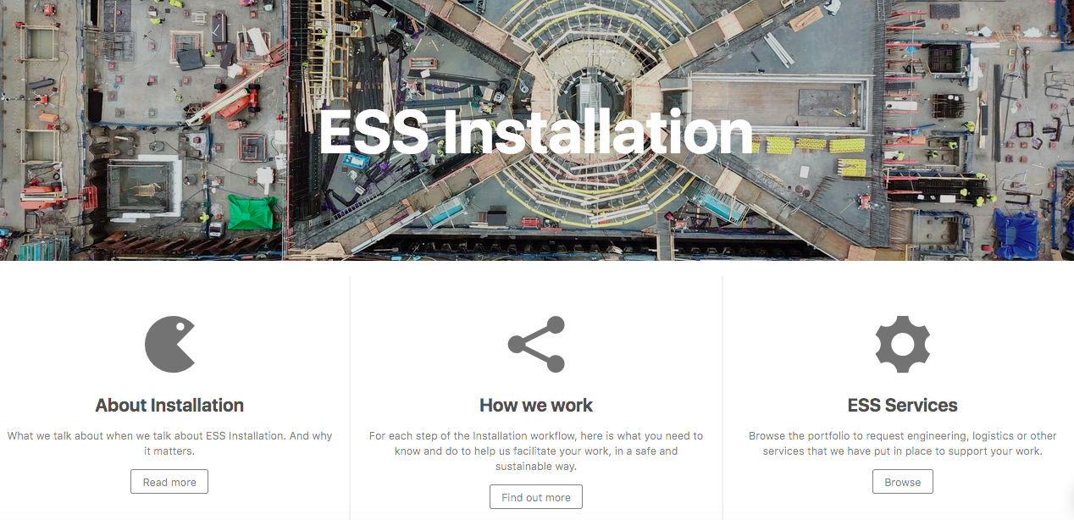
ESS Installation Web-based Guide
https://confluence.esss.lu.se/category/essinst
Notes:
The ESS Installation website is the communication platform we have put in place to enable Installation work.
Eventually 4 pillars:
1. About installation (What we talk about when we talk about Installation. And why it matters.)
2. How we work (For each step of the Installation workflow, here is what you need to know and do to help us facilitate your work, in a safe and sustainable way.)
3. ESS Services (Browse the portfolio to request engineering, logistics or other services that we have put in place to support your work.)
4 What’s going on (announcement and updates about installations)

Slide 9
Partners & Installation
Same process (as all other installations)
Break down full scope in suitable installation packages
Clarify ESS counterpart (Installation Package Leader)
Prepare each package according to process
Perform installation of package
Identification of needed support & services

Slide 10
Services #1
Contact person:
kristofer.falkland@esss.se
Contact person
fabien.rey@esss.se
kristofer.falkland@esss.se

Slide 11
Services #2
Temporary cooling
Temporary power
Building modifications
Contact person:
malin.aberg@esss.se
Contact person:
jorgen.larsson@esss.se
Contact person:
therese.welander@esss.se

Slide 12
Services #3

Slide 13
Types of Services & Support
ESS Installation Organization
Process guidance, support, information, ESH etc. (no central workforce)
Mandatory & Free Services
Temporary power, temporary cooling, building modifications, survey and alignement etc
Mandatory Services
Scaffolding, Rigging
Other Services
Electrical support, Mechanical support, Equipment, Cleaning, etc.

